Slide 1
Memory Card Reader
Structure & Circuit Design
Name : Srushti Bhamare (19D170006)
Instructor : Prof.Rajesh Gupta
EN 209

Slide 2
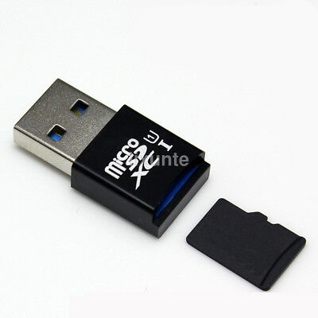
What is the Memory card Reader?
SD card reader is a small USB plug-and-play device that can be used to read data from portable flash memory cards like MicroSD, Mini SD or SD cards. You can read data from your memory cards, perform copy, paste, more or backup data from it to your computer with the help of SD card readers.
Having connected to PC, you can move, copy, paste or backup your data from your memory card to your computer. So the main function of a card reader is to help you work with memory card & a computer.

Slide 3
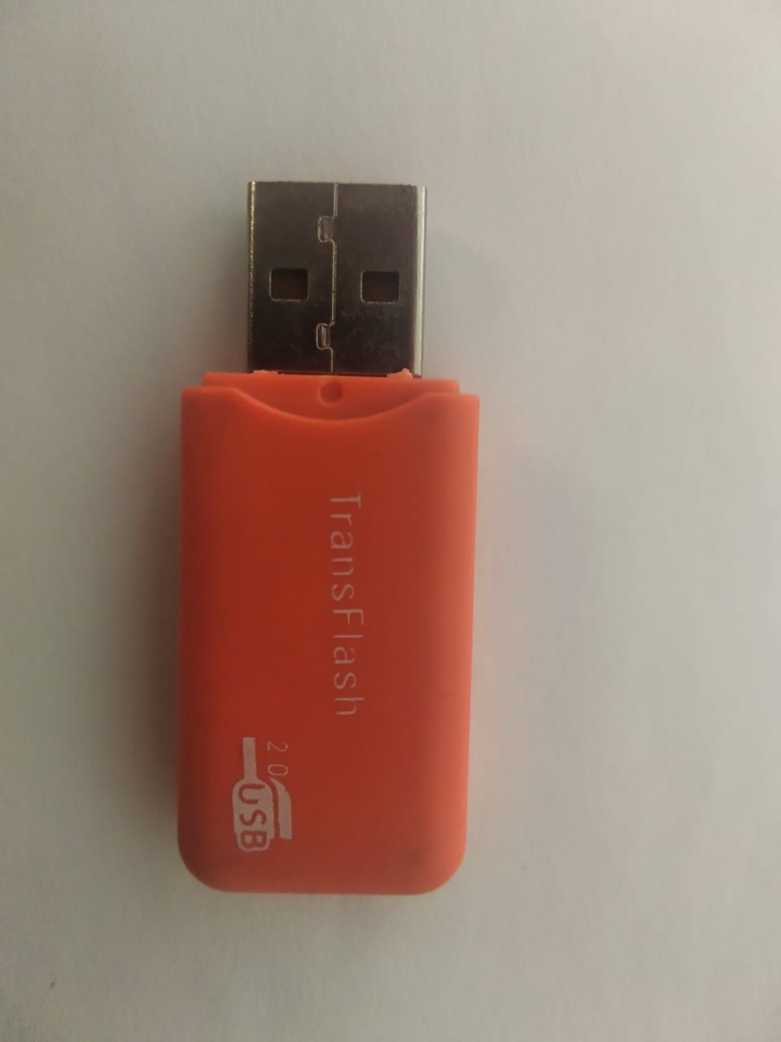
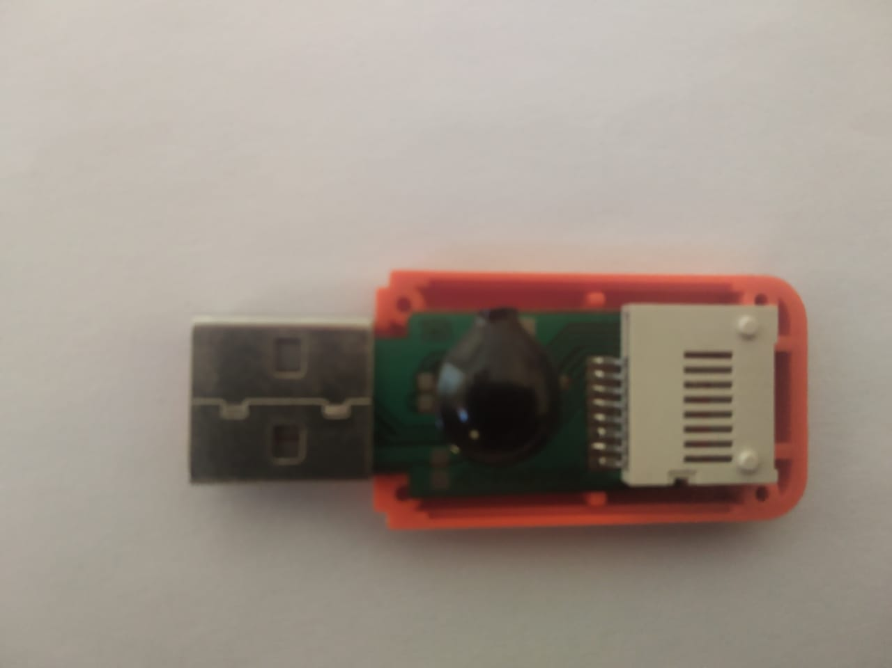


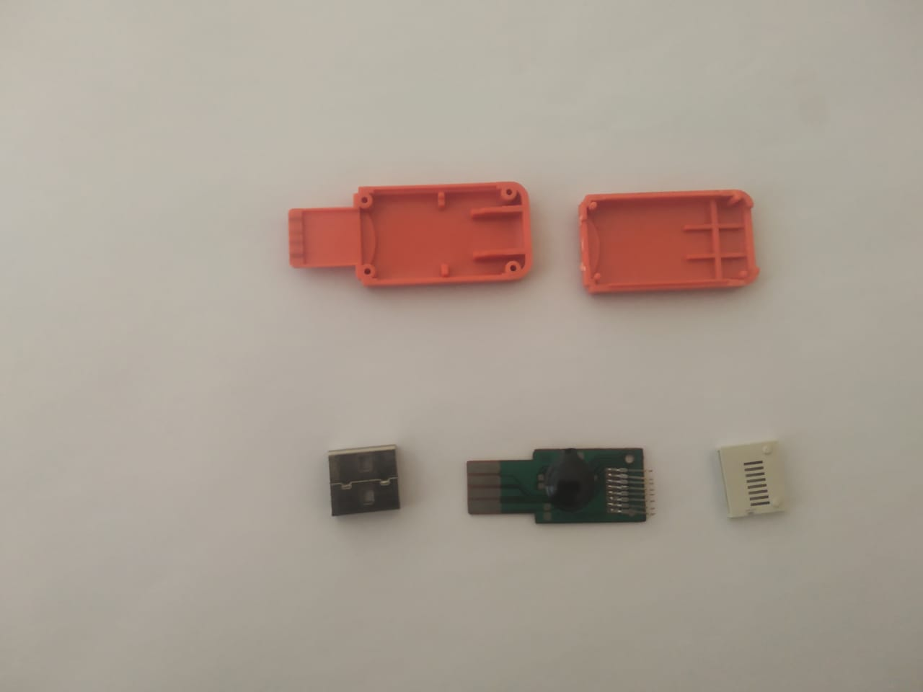
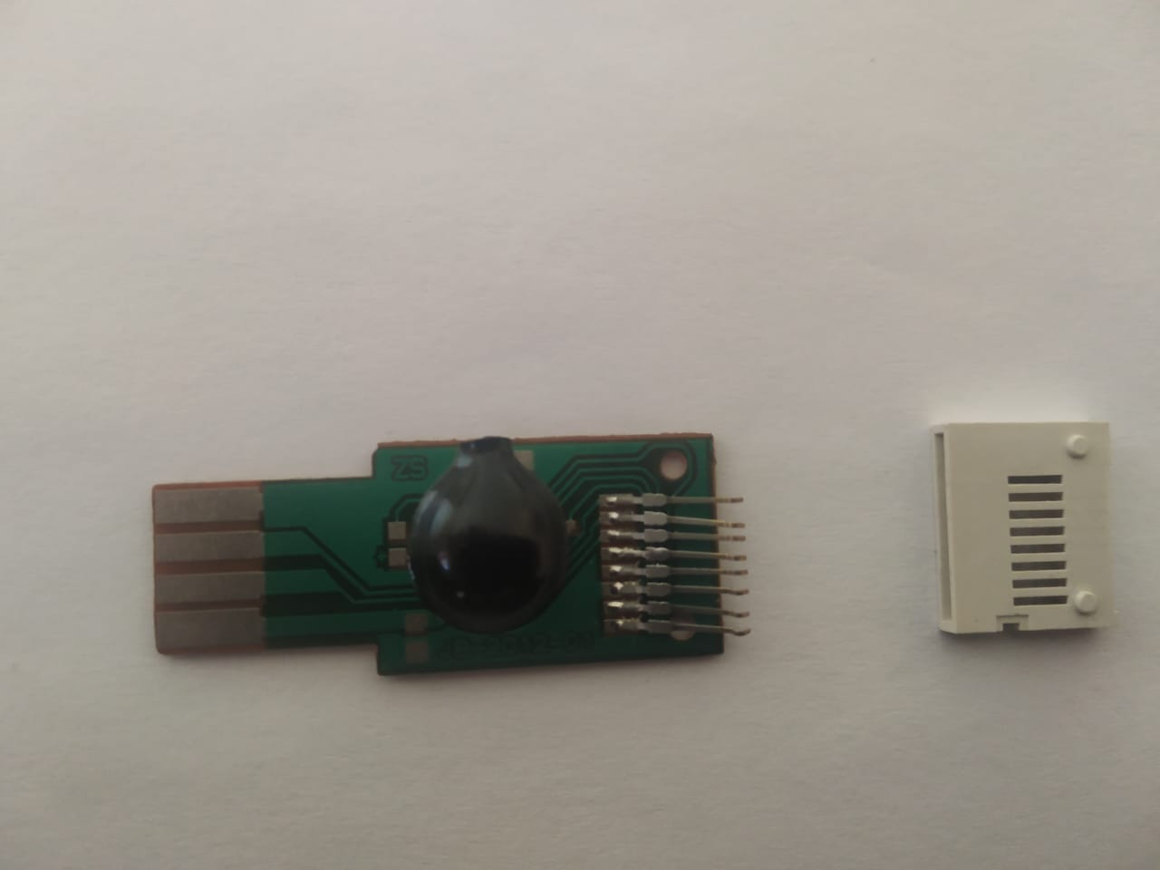
Steps Involved

Slide 4
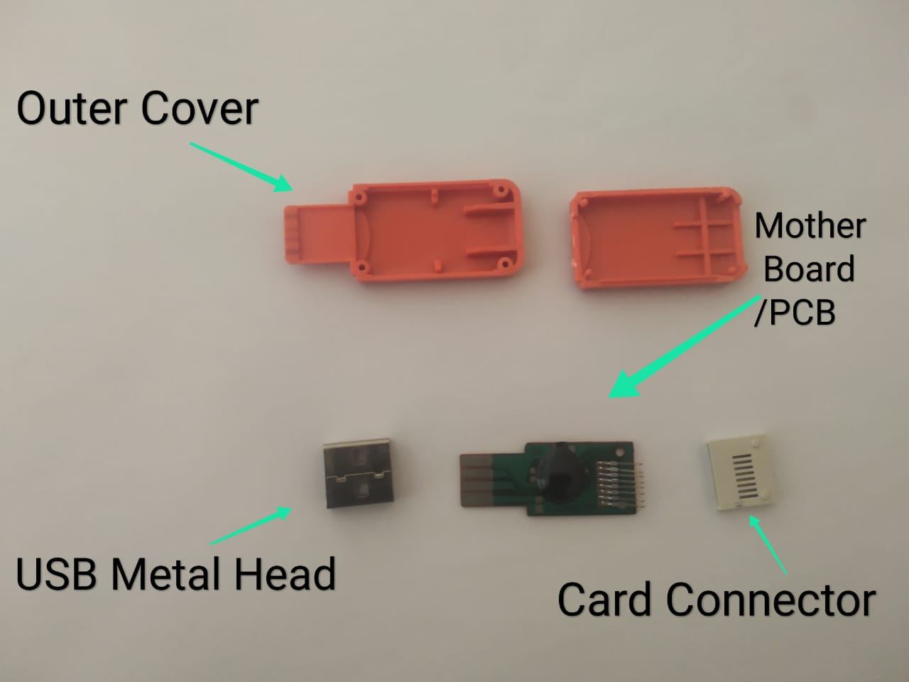
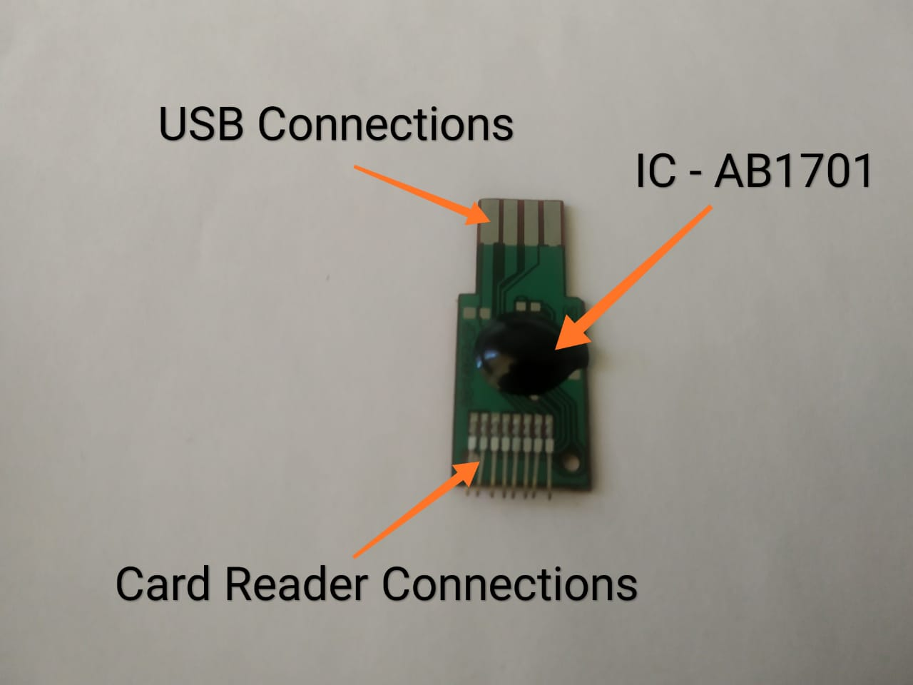
Memory Card Reader: Different parts and its structure

Slide 5
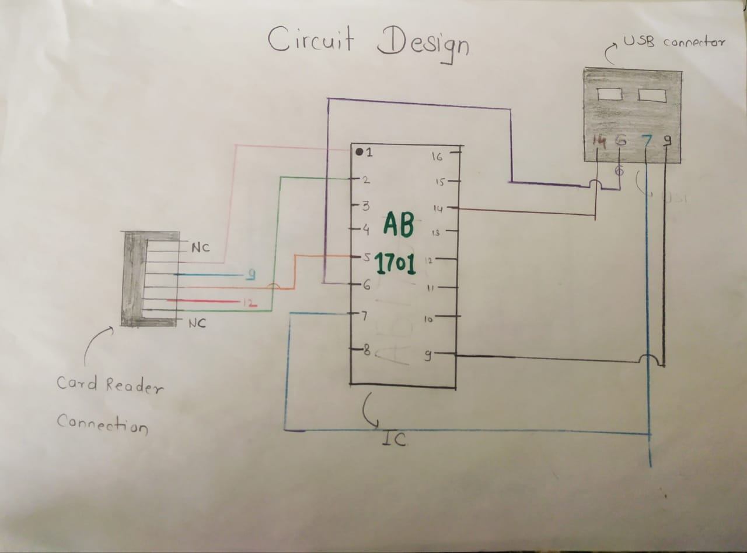
Circuit Design

Slide 6
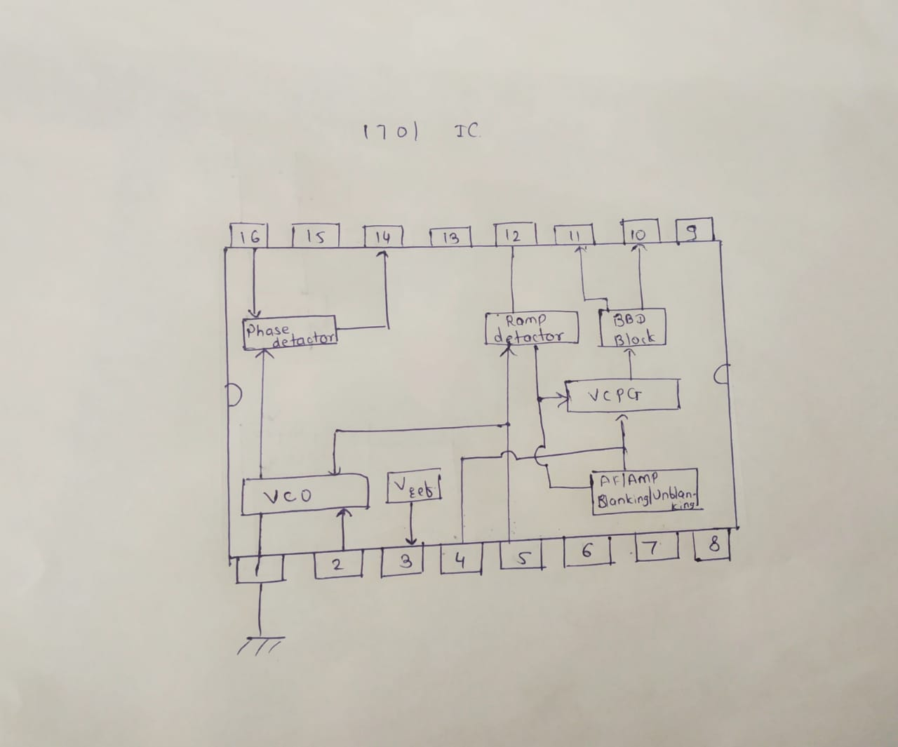
Circuit of IC

Slide 7
Functions of different Parts of card-reader
1]Card Connector: It is simple memory card sized component which is made to fit memory card in it and connectors are fitted into it.
2]8 connections of reading memory Card: The first part of ‘Circuit design diagram’ are 8 connectors which take data from memory card and send it to IC .Memory card also have 8 readable connections on it.
3]USB Connector: The USB is a plug-and-play interface between the PC and the peripherals. USB is the short form of Universal Serial Bus, a standard port that helps to connect computer peripherals like scanner, printer, digital camera, flash drive and more to the Computer.
4]IC – 1701: It is used to read the data from memory card and transfers that data into computer.

Slide 8
Additional Information
There are different types of card readers. Those types are as follows:
1] Smart card readers.
2] Memory card readers.
3] Access control card reader. 3.1 Barcode. 3.2 Biometric. 3.3 Magnetic stripe. 3.4 Wiegand card. 3.5 Proximity card. 3.6 Smart card.
4] Banking card readers.
Some of these card readers are associated with barcode,QR code so there are different IC’s used in different card reader.

Slide 9


